Slide 1
Statistical Modeling and Bayesian Inference for Industrial Applications
Daniel Watzenig
Graz University of Technology
and
VIRTUAL VEHICLE Research Center Graz
Matthias K. Scharrer
VIRTUAL VEHICLE Research Center Graz

Slide 2
Outline
  Electrical capacitance tomography
    Motivation
    HW setup
    Statistical modeling
    Inverse problem (Bayesian inference)
  Lithium-ion batteries
    Motivation
    Electrochemical model
    Parameter estimation
    Uncertainty quantification
  Concluding remarks

Slide 3
Outline
  Electrical capacitance tomography
    Motivation
    HW setup
    Statistical modeling
    Inverse problem (Bayesian inference)
  Lithium-ion batteries
    Motivation
    Electrochemical model
    Parameter estimation
    Uncertainty quantification
  Concluding remarks

Slide 4
Motivation
Why process monitoring?
  process design, control, optimization
  determination of process parameters
  that can‘t be measured directly
Electrical capacitance tomography
  non-conducting materials
  heterogeneous flow structures
  nonivasive
  robust and cheap (e.g. X-Ray)
Constraints and requirements
  robust estimation of current process state and process parameters
  measurement uncertainties
  non-stationary material distributions (fluid dynamics)
  harsh environmental conditions (pressure, temperature)

Slide 5
Sensor electronics requirements
Accurate measurement of very small inter-electrode capacitances in the range of 1 fF to 5 pF in the presence of stray capacitances of the order of 150 pF
High dynamic range of the amplifying circuitry to cover a wide range of magnitudes for electrodes adjacent and opposite to the transmitting one and to be able to consider both low- and high-contrast problems in permittivity
High measurement resolution since capacitance changes caused by permittivity variations are very small
Shielding for all sensor circuits to reduce cross-talk between transmitting and receiving electrodes.
Parallel measurement of receiving channels
The possibility of sensor calibration (circuitry adjustment)
…

Slide 6
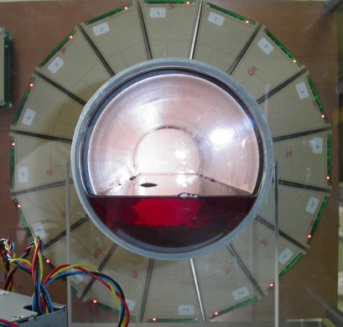
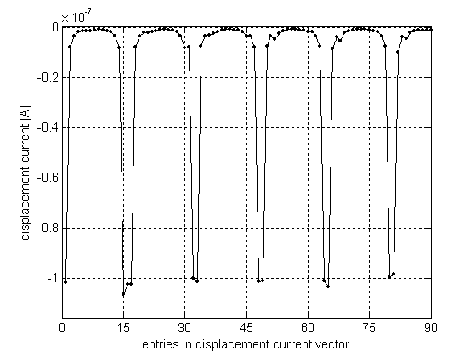
ECT sensor
16 electrodes
40 MHz
1 fF – 5 pF
100 frames/s
60 dB linear range

Slide 7
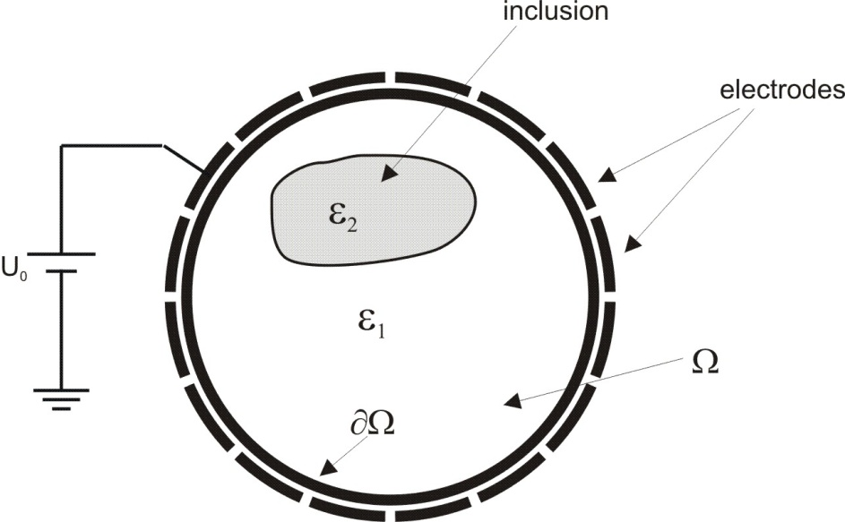
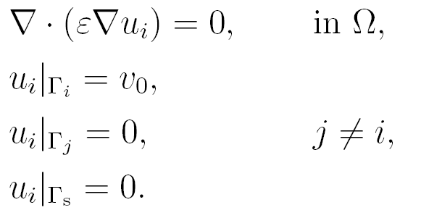
Forward modeling
Derived from Maxwell‘s equations for the electrostatic case
Only Dirichlet boundary conditions
Numerical modeling:
  FEM-based model
  BEM-based model

Slide 8
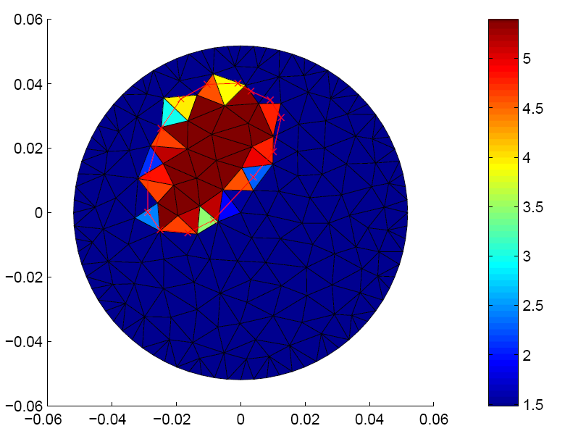
FEM-based model
Only Dirichlet boundary conditions
Discretization error

Slide 9
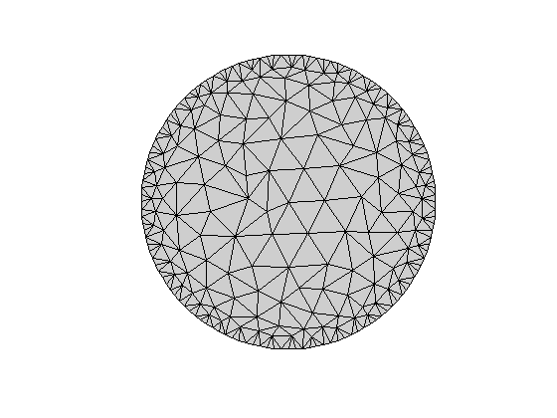
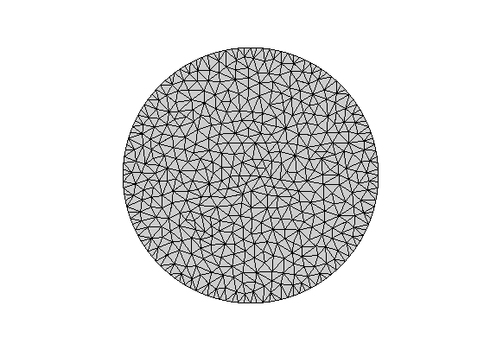
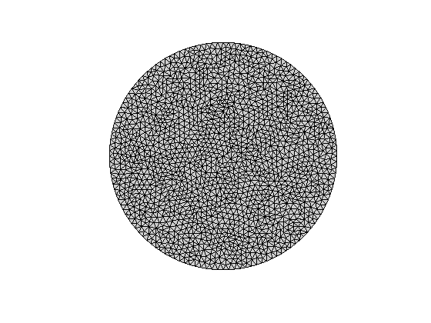

FEM-based model - different meshes
mesh #1: 400 DoF
mesh #4: 926 DoF
mesh #10: 3182 DoF

Slide 10
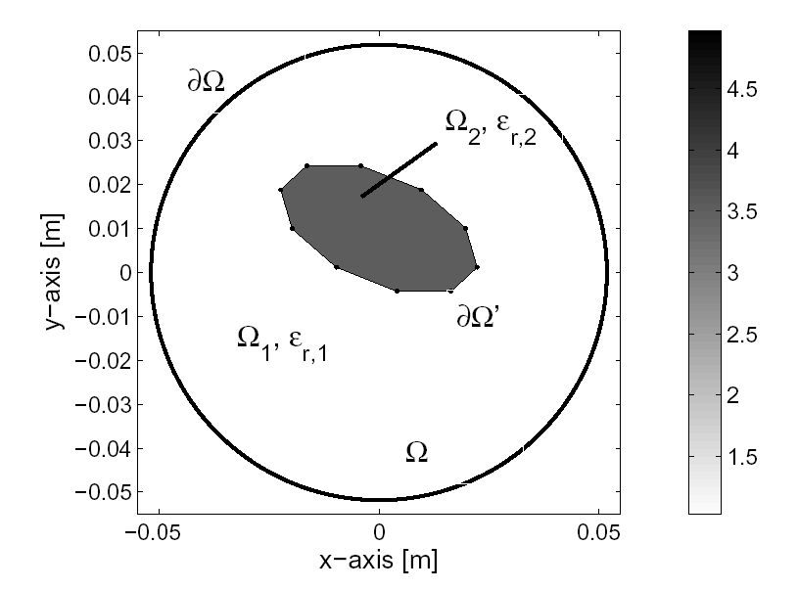
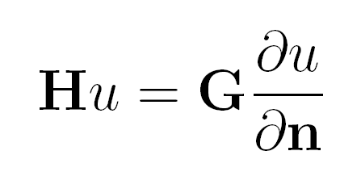
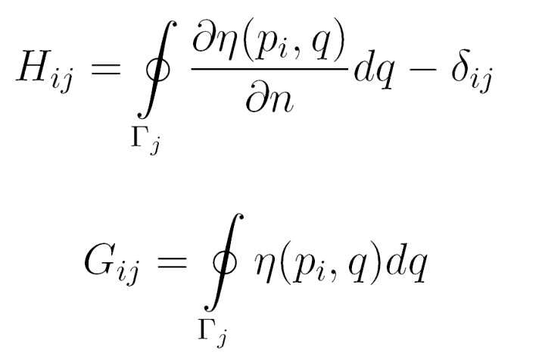
Mathematical modeling using the BEM
BEM equations

Slide 11
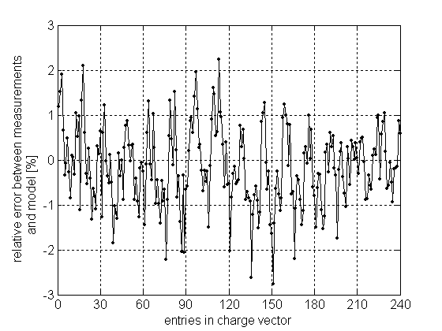
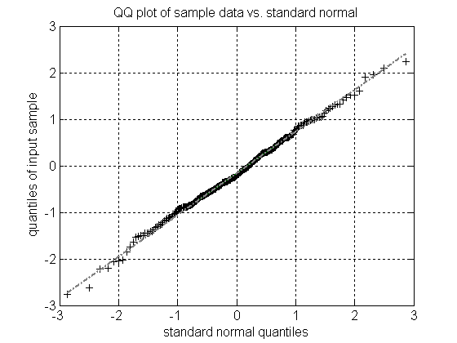
Model calibration

Slide 12
Measurement noise
e.g. electrode #4
10000 repeated measurements
prescribed material distribution

Slide 13
Data inversion
Linear methods
  e.g. linear back projection
Regularization methods for inverse problems
  based on data misfit criterion (least squares)
  choice of the regularization parameter (L-curve criterion, discrepancy principle,...)
Statistical inversion
  Markov chain Monte Carlo (MCMC)
  recursive Bayesian filtering (Kalman filter, particle filter,…)

Slide 14
Regularization
Is well developed and methods often successful
Cannot handle well or at all
  Large noise cases
  Uncertainty in models
  Heavily approximate models (computational limitations: memory and/or time)
  Time-varying problems

Slide 15
Statistical vs. deterministic inversion
Deterministic approach
  Usually much easier to set up
  Often efficient computational methods to solve
  Essentially tries to minimize residuals (with constraints)
Statistical inversion
  Greater modeling effort
  Often computationally heavy and difficult to implement
  Depending on the problem might not be worthwhile
  Allows for the testing of all assumptions

Slide 16
Statistical vs. deterministic inversion
any kind of forward map can be treated
By taking into account measurement uncertainties, a range of parameters that are consistent with the measured data can be quantified.
Incorporation of measurement noise models (even in case of non-Gaussian noise distributions)
The parameter space can be
  discrete,
  discontinuous,
  or even of variable dimension.
Prior knowledge on the parameters can be taken into account in a very natural way by specifying an appropriate prior distribution.

Slide 17
Statistical vs. deterministic inversion
Since not only the most likely solution of the problem is found, statistical methods result in robust estimates even for high-dimensional nonlinear problems.
marginal densities as well as summary statistics of the parameter of interest can be determined
Recursive statistical filters such as Kalman filters (KFs) and Particle filters (PFs), which rely on a state-space formulation of the problem, are able to solve non-stationary inverse problems given process noise and uncertain measurements.

Slide 18

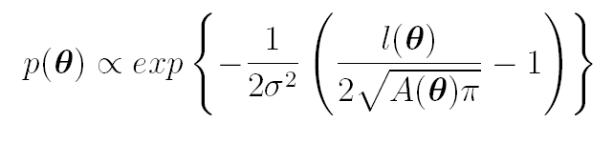
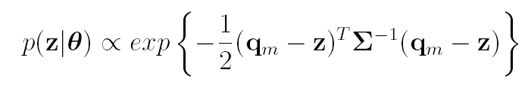
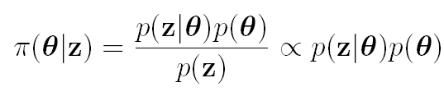
Bayesian model
prior distribution
likelihood function
posterior distribution

Slide 19
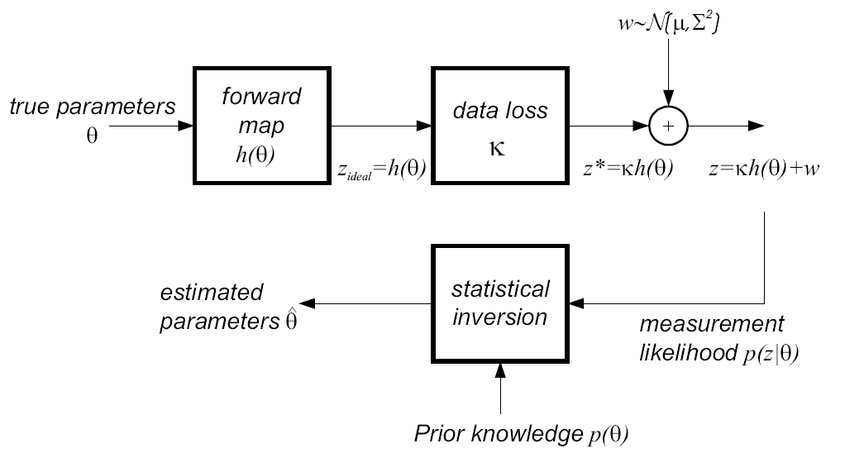
Stochastic model

Slide 20
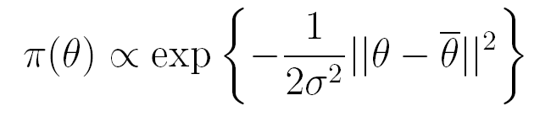
A-priori models
Low-level models
  Gaussian priors
  Markov Random Fields (MRF)
  Sample-based priors
  Impulse noise priors
Mid-level models: generic structure information
  structural priors
  parameterized curves
High-level models
  Parameter spaces with varying dimensions

Slide 21



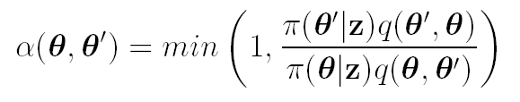
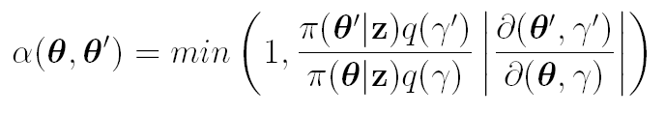



MCMC with Metropolis-Hastings dynamics
Given
new candidate with
acceptance ratio
accept: if
reject: otherwise
repeat

Slide 22



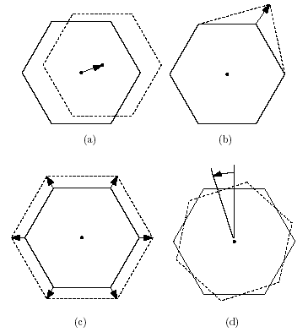



Proposing a new state
Translation
Vertex move
Scaling
Rotation
N=4 different moves
Probability of choosing a move
Overall transition probability

Slide 23
Acceptance rate
It is important to monitor the acceptance rate (the fraction of candidate draws that are accepted) of your Metropolis-Hastings algorithm.
If your acceptance rate is too high, the chain is probably not mixing well (not moving around the parameter space quickly enough).
If your acceptance rate is too low, your algorithm is too inefficient (rejecting too many candidate draws).
What is too high and too low depends on your specific algorithm, but generally
  random walk: somewhere between 0.25 and 0.50 is recommended
  independent: something close to 1 is preferred

Slide 24
Solution of the inverse problem
The MCMC methods are algorithms that allow for generating such an ensemble of draws.
The most commonly used algorithms are the Metropolis-Hastings algorithm and the Gibbs sampler.
Both are often easy to implement and effective in small dimensional cases – typically difficult to make efficient in large dimensional cases.
Note that in principle sampling does not necessitate any regularity of the density, such as differentiability.
The honesty in statistical inversion: if the data is poor and the models contain significant uncertainty, the variance of the estimate can be very large.

Slide 25


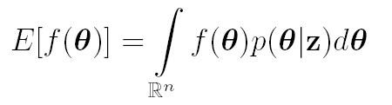
Solution of the inverse problem
Posterior distribution contains all information
Point estimators (modes)
  Maximum Likelihood
  Maximum a posteriori
Inferential solutions (expectations)
posterior distribution conditioned on measurements and prior information.
Marginal densities, confidence intervals

Slide 26
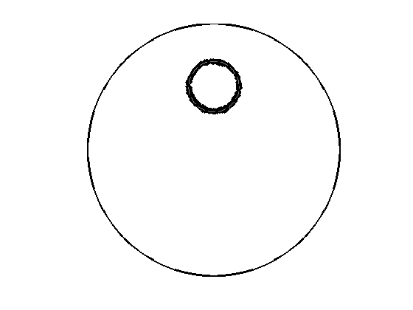
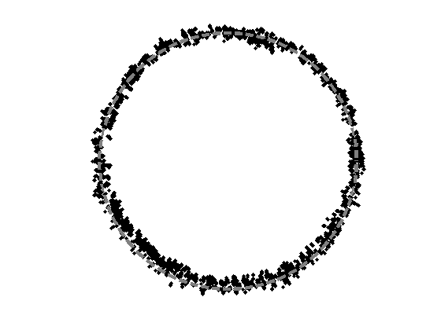
Reconstruction results
PVC pipe (100 mm)
detail plot
area
circumference

Slide 27
Reconstructed parameters
Statistical efficiency

Slide 28
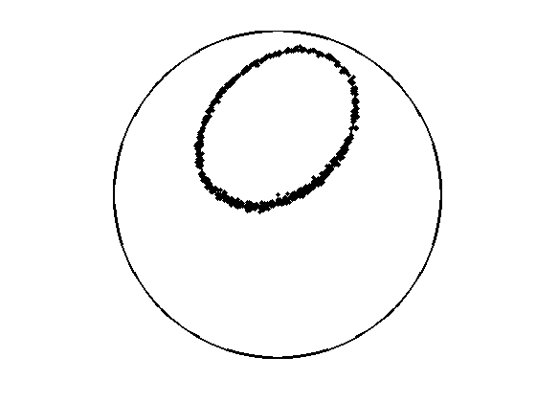
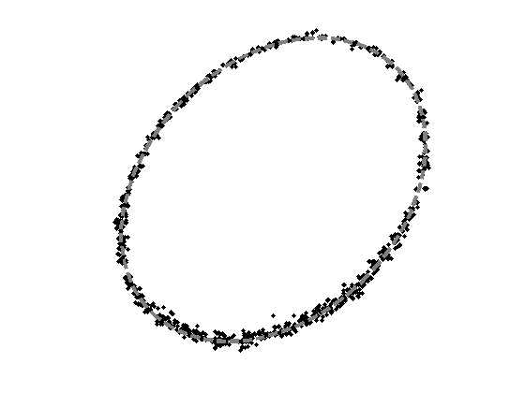
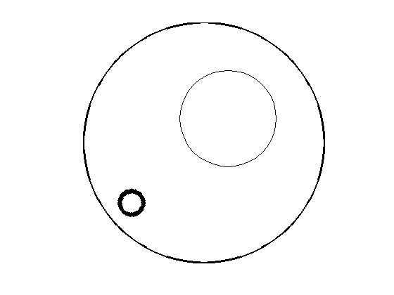
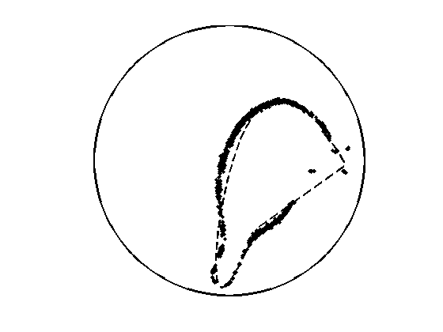
Reconstruction results
elliptic contour
Detailed scatterplot
circular contour
complex contour

Slide 29
Statistical efficiency
Position (x,y)
Likelihood

Slide 30
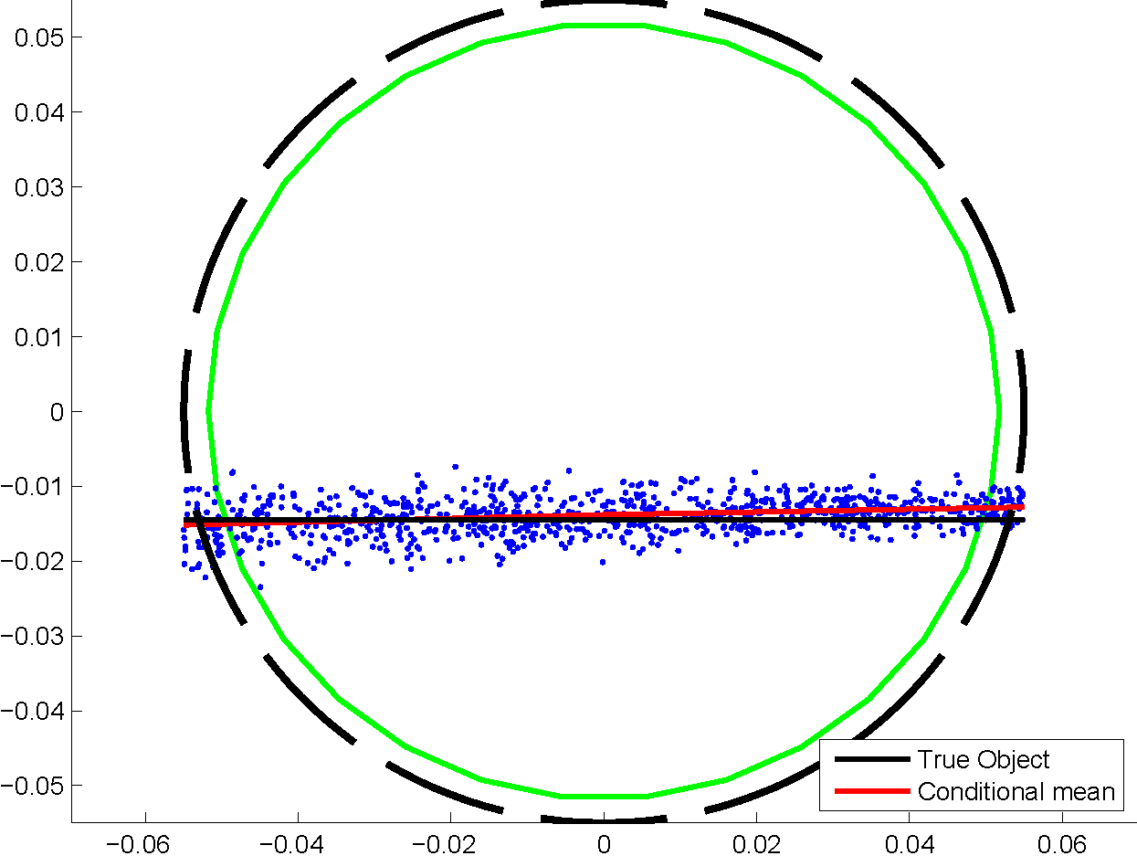
Reconstruction results
material distribution
Scatter plot and conditional mean estimate

Slide 31
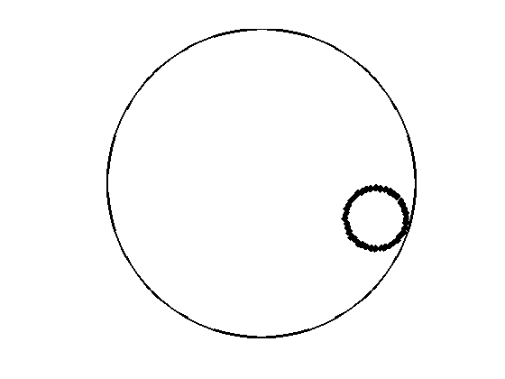
Reconstruction based on data

Slide 32
Statistical efficiency and IACT
Markov chain: the less consecutive states of the chain are correlated the more reliable estimates are obtainable.
The Integrated Autocorrelation Time (IACT) and can be interpreted as the number of correlated samples with the same variance-reducing power as one independent sample.
For a given posterior distribution the Markov chain should designed in way that the IACT is as small as possible implying a small variance of the estimate without needing a large sample set N.
The rate IACT/N at which the variance of the estimate reduces is called statistical efficiency.

Slide 33
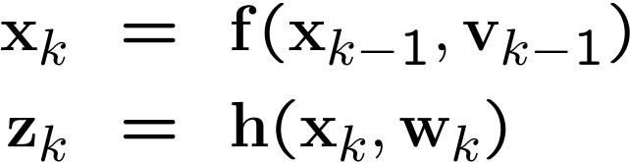
Bayesian recursive filtering
Kalman filter, extended, unscented, sigma point, particle filter, …
Tomography:
  Closed contours are boundaries between regions with different electric properties
Mid-level model (Fourier descriptors, B-spline, RBFs,…)
State transition and measurement model at time instant k
problem of estimating the current contour of a dynamic system

Slide 34
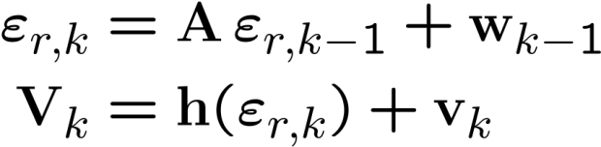
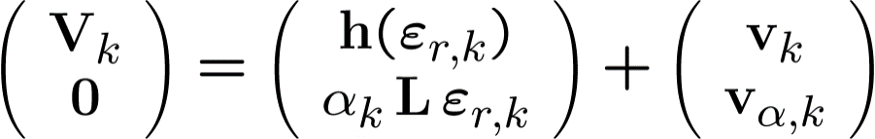

State estimation using Kalman technique
State-space for ECT
Approximation:
Regularization:
Filter update

Slide 35
H∞ filtering
Forward maps are typically finite dimensional approximations of the infinite dimensional underlying problem.
The discretization error may become significant compared to the measurement error
Compared to the measurement error, the model error can also be biased, whereas the measurement error has typically a negligible bias.
Aim: find best parameter estimation, assuming worst case simulation results.

Slide 36



State-space modeling
Linear system theory
Estimation problem: find an estimate for x using prior knowledge about the previous state
Kalman filter
H∞ filter

Slide 37
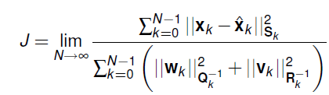
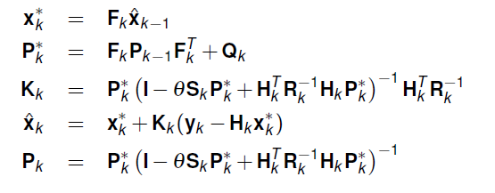
The approach
S, Q and R are the design parameters of the filter. For J < 1/θ a recursive filter can be obtained:
No statistical assumptions are made during the derivations!

Slide 38
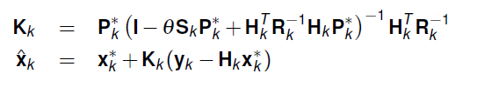
Difference to the KF
For θ=0 the filter reduces to the Kalman filter
As no assumptions about w_{k} and v_{k} are made during the design process, this is robust by design.
→ best estimate for x_{k} under worst case assumptions

Slide 39
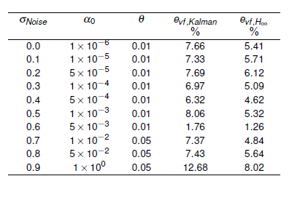

Results for ECT
Statistical evaluation of the void fraction error:

Slide 40
Quick summary
The H∞ filter is as robust version of the Kalman filter.
The used models for solving the inverse problem in ECT can suffer from large model errors → model-order reduction
H∞ filter is able to outperform Kalman filters in the presence of model errors and/or large measurement errors.

Slide 41
The particle filter
Complete representation of the posterior distribution of the system states – set of samples
Any nonlinearities and any distributions
Maintains multi-modal hypotheses
Calculation of the Jacobian is not required
Resampling stage (Gordon et al. 1993)
Design of proposal distribution is required
multiple solutions of the forward problem are required

Slide 42
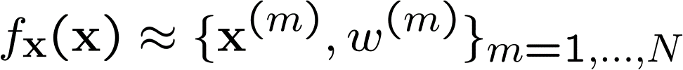
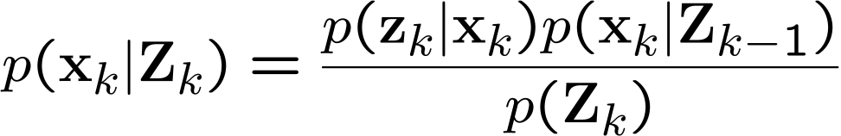
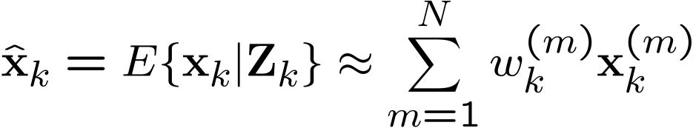
Signal processing – particle filter
Stochastic sampling:
Prediction based on the state transition model
Measurement update based on the measurement model
Set of samples to approximate the posterior distribution
Expected value based on these samples

Slide 43
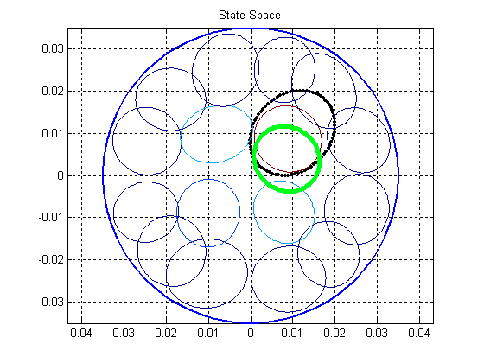
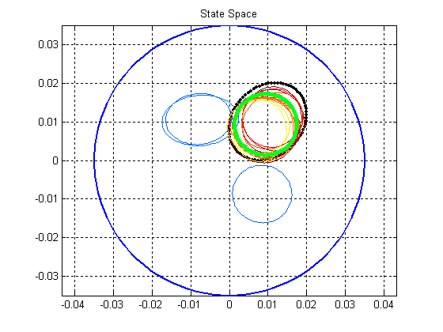
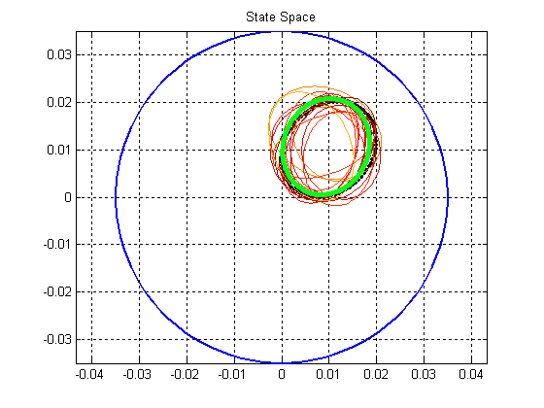
PF-based reconstruction
Estimation result of PF with B-spline contour representation for different iterations (2, 4 and 25)

Slide 44
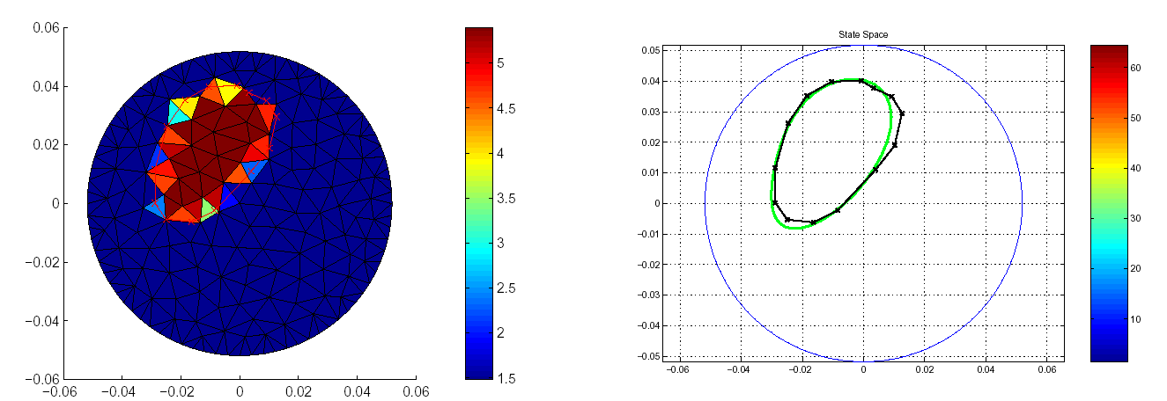
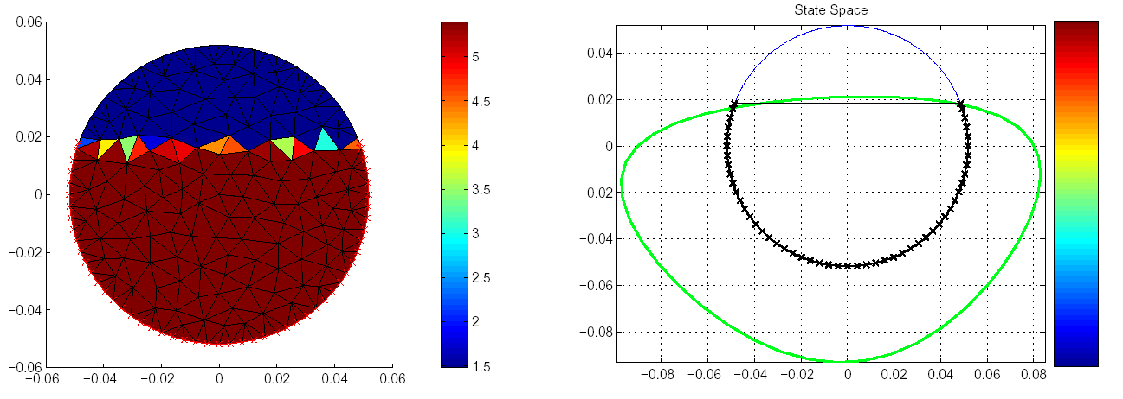
Reconstruction results (FEM-based model)

Slide 45
Brief summary ECT
Robust estimates (calculation of properties such as void fraction)
Quantified error estimates (GUM)
Parameter spaces can be discrete, discontinuous, or even of variable dimension
Arbitrary forward maps and error distributions
Increased computational effort
Greater modelling effort
Non-stationary problem: random walk model

Slide 46
Outline
  Electrical capacitance tomography
    Motivation
    HW setup
    Statistical modeling
    Inverse problem (Bayesian inference)
  Lithium-ion batteries
    Motivation
    Electrochemical model
    Parameter estimation
    Uncertainty quantification
  Concluding remarks

Slide 47
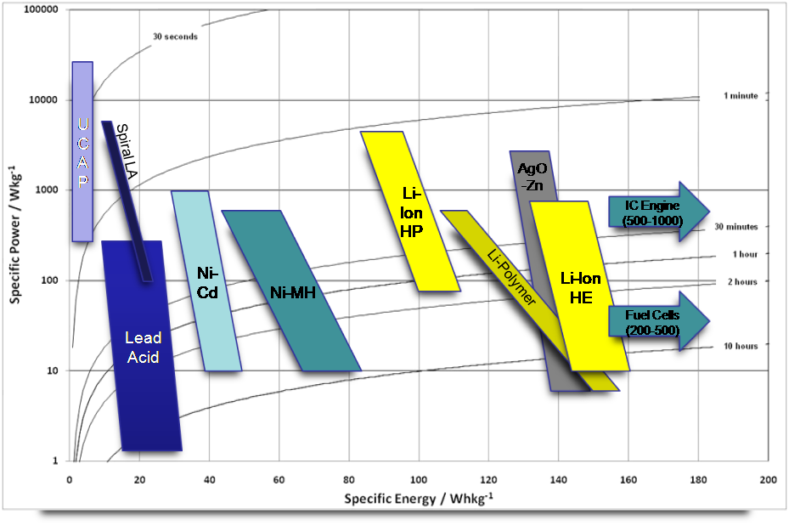
Ragone chart

Slide 48
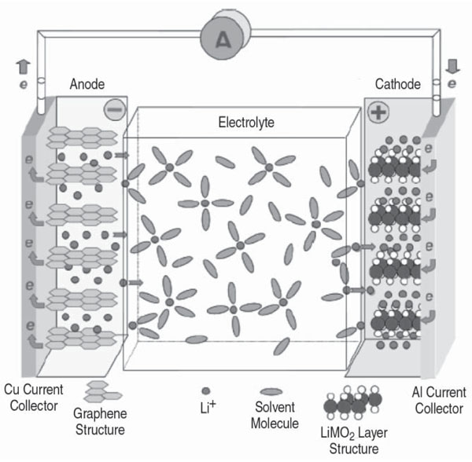
The Electrochemical Cell (I)
Simplest form of a battery
  Separated anode & cathode
  (intercalation electrodes)
  Chemically connected
  by electrolyte
“Charged”
→ Fully intercalated anode
→ Fully depleted cathode
“Discharging”
→ ions de-intercalate in anode, electrons dissociate
→ ions migrate through electrolyte to cathode, electrons power device
→ ions associate with electrons in cathode and intercalate
Source: Klaus Daniel, Materials and Processing for Lithium-ion Batteries, Journal of Metals Vol. 60, No.9, 2008

Slide 49
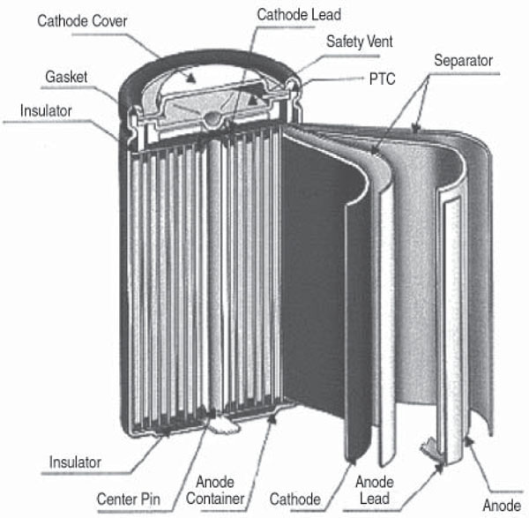
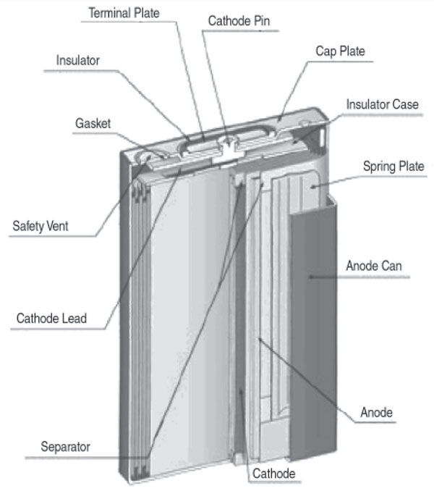
Common Battery Forms
a schematic of a cylindrical cell. a schematic of a prismatic cell
Source: Klaus Daniel, Materials and Processing for Lithium-ion Batteries, Journal of Metals Vol. 60, No.9, 2008

Slide 50
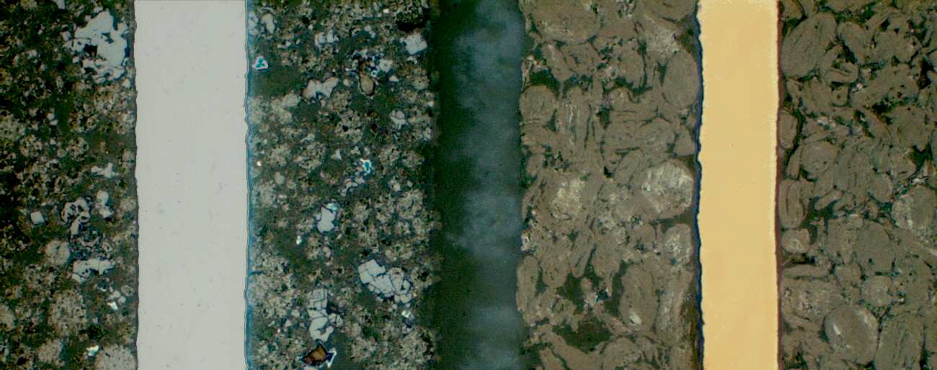

The Electrochemical Cell (II)
Al-Collector
Separator
Cu-Collector
Real systems consist of
porous electrodes of high geometrical complexity
For modeling, several idealizations are made:
Particles are spheres
Distribution of the particles is assumed homogenous w.r.t. to size and location within a region
Additives, binder, graphite bridges, … are not considered
Anode
Cathode
LM
SEM
Source: Thomas et al., Correlative Light and Electron Microscopy (CLEM) for Characterization of Lithium Ion Battery Materials, Microscopy and Microanalysis, 16, 2010

Slide 51
Problem Formulation I
~
~
~
~
~
~
~
~
~
~
~
~
~
~
~
~
~
~
~
~
~
~
~
~
~
~
~
~
~
~
~
~
~
~
r
x
~
~
~
~
~
~
~
~
~
~
~
~
~
~
~
~
~
~
~
~
~
~
~
~
~
~
~
~
~
~
~
~
~
Current Collector
Negative Electrode
Separator
Positive Electrode
Current Collector
e⁻
Electrolyte
e⁻
r
Li⁺
r
Li_{x}C₆
Li_{y}FePO₄
Separated intercalation electrodes (anode & cathode)
Chemically connected by electrolyte
Capture basic thermal, electrical and chemical
Direct simulation not feasible (nm-scale up to mm-scale)
→ Homogenized model of [Doyle] et al.
[Doyle] Doyle, Fuller, and Newman: J. Electrochem. Soc., 140 (6), 1993, 1526-1533.

Slide 52


Problem Formulation II
Solid potential:
Liquid potential:
Liquid ion diffusion:
Solid ion diffusion:
Coupling between
solid and liquid:
… Unknowns
… Parameters

Slide 53


Parameter Sensitivities
„Factor Fixing“ by „Morris one at a Time“ (MOAT) – ext. by [Saltelli]
Sensitivity measures:
  Mean
  Std. Deviation
of elementary effects
Parameters of interest e.g.
Stronger Non-Linearity and/or Interaction
Stronger direct Influence
[Saltelli] Saltelli et al., Sensitivity Analysis in Practice: A Guide to Assessing Scientific Models, Wiley, 2004

Slide 54
Inside the Cell (I)
Example Profile:
Start: Empty cell (0% State of Charge)
Charge at 1C current until voltage of full cell reached (spec)
(1C = current to achive full discharge in 1h)
  At 20%, 50% and 80% SoC overlay pulses at 1C
  Charge at 2C, Rest at 0C for 49s alternating three times
Hold voltage until current drops below C/20
Rest for 100s
Discharge at 1C current until voltage of empty cell reached
  At 20%, 50% and 80% SoC overlay pulses at 1C
  Discharge at 2C, Rest at 0C for 49s alternating three times
Hold voltage until current drops below C/20

Slide 55

Inside the Cell (II)

Slide 56


Parameter Sensitivities
Investigate effect of parameters on the output
Compare results of simulated cell voltage to measurements
(based on hybrid module measurements) for different parameter sets
Voltage [V]
Time [s]

Slide 57
Parameter Estimation
Which method to use?
Direct, deterministic methods?
  Not very fast
Gradient-based, deterministic methods?
  Favorable, but how to compute ?
Stochastic methods?
  Really slow

Slide 58
Parameter Estimation using Space Mapping
… fast surrogate model based optimization method
introduced by [Bandler]
Requirements: two models
slow/complex “fine“ (basis) model f (p)
very fast “coarse“ Model c(b),
e.g. linearization around working point
Idea:
use „coarse“ Model c(b) as surrogate for the „fine“ f (p)
find a relation (mapping) between b and p
Reduce the number of evaluations of f (p)
Estimate gradient ∇_{b}c(b) of c(b) only
[Bandler] Bandler et al.: IEEE Trans. on Microwave Theory & Techn., 42 (12), 1994, 2536-2544

Slide 59
Parameter Estimation using Space Mapping
Initialize B_{k} = I, p_{k} = b_{k} = p₀
update mapping approximate
compute new candidate
evaluate fine model for the candidate
and decide about acceptance
Find “coarse” parameter
corresponding to
Apply Broyden’s method to improve
→ Jacobian of mapping function
… repeat until criterion is met, e.g. residual < e
coarse
model
fine
model
coarse
model

Slide 60






Parameter Estimation using Space Mapping
fine model – nonlinear PDEs:
coarse model – linearized PDEs:
enables computation of and
a lot faster than

Slide 61

Parameter Estimation using Space Mapping
~11.8±0.19s for
~2.95±0.07s for
Performance comparison:
direct optimization: 1947s (165 calls of )
Final residual 7.70E-13
space mapping optimization: 1469s (7 calls of /
549 calls of )
Target curve and result very close
Initial curve
→ Reduction of computation time of ~25% for two parameters up to 50% without much effort

Slide 62



Parameter Estimation using Space Mapping
fine model – nonlinear PDEs:
coarse model – linearized PDEs:
adjoint model – linear PDEs, similar to:
Simulation
result
Measurement
enables computation of and
independent of parameter number!

Slide 63


Parameter Estimation using Space Mapping
„recover target parameter by observing cell voltage only“
Parameters of interest
  Target values
  Bounds – box constraints:
    lower
    upper
optimization objective function
split into sub-problems
Starting curve
Cell voltage u(t)
Target
curve
Error
Time t

Slide 64

Parameter Estimation using Space Mapping
Compare gradient estimation by finite differences to adjoint system
⇒ time saving of 80% in a 3D case

Slide 65
Parameter Estimation using Space Mapping
Prerequisite:
Observation/Measurement
detailed (slow) model
fast model
Apply Space Mapping based on surrogate optimization
⇒ Obtain best parameter set
What next?
⇒ Investigate uncertainty

Slide 66


Uncertainty Quantification
Measurements are subject to error
Parameters are not exact values
Two possibilities to learn about probabilities
Perturb the measured data and refit the parameters.
Perturb parameters, accept parameter values that give good enough fits to data, reject others.
⇒ Very intuitive, Bayesian approach

Slide 67




Bayesian Uncertainty Quantification
Apply Bayes Law
Likelihood:
Prior
Posterior distribution
Apply e.g. Markov Chain Monte Carlo (MCMC)

Slide 68

Metropolis Hastings algorithm
But how to choose this proposal distribution?

Slide 69

Parallel adaptive MH sampling algorithm
Source: Solonen et al., Efficient MCMC for Climate Model Parameter Estimation: Parallel Adaptive Chains and Early Rejection, Bayesian Analysis, Vol. 7, 2012
Run several chains in parallel
Start with some proposal distribution Σ₀
Regularly Update Σ by computing the samples covariance

Slide 70

Tests performed
short, high current pulse
followed by rest step
Apply several variants:
No noise, 6 parallel chains
20k samples
Noisy data, 5 parallel chains
2.5k samples
Noisy data, 3 individual chains
2.5k samples
Noise: Gaussian white noise σ=0.001V

Slide 71






Quantified Uncertainties

Slide 72

Quantified Uncertainties
#A Parallel chains without noise
#B Parallel chains with noise
#C,#D,#E individual chains with noise

Slide 73

Quantified Uncertainties
Scharrer, Haario, Watzenig: “Automotive Battery Technology”, 2014

Slide 74


Sample autocorrelation – statistical efficiency
Number of samples in the chain to reach statistical independence ≈50

Slide 75
Ageing of lithium-ionen cells
Calendrical ageing
    Storage of cells without cycling
    Growing of SEI on graphite of anode → Increase of internal cell resistance → Decrease of discharge capacitance (cut-off voltage is hit earlier)
Cyclic ageing
    Charge / discharge
Variations and tolerances
    Geometry of electrodes
    Contamination
Acceleration of ageing effects
    Increase of temperature
    Increase of electric charge/discharge current
    Lifting/lowering of operation voltage limits

Slide 76

Examples for cell ageing processes
CAUSES
FAILURE
EFFECTS
electrolyte decomposition
high temperatures
accessible surface decrease
high SoC
porosity changes
metal Li plating
power fade
(RI, IC)
overcharge
binder decomposition
high current rates
gas evolution
contact loss
high DoD
current collector corrosion
capacity fade
(CD)
particle micro cracking
low temperatures
particle structural disordering
over discharge
material dissolution
cathode surface layer formation
high SoC swing
. . . . . .
Based on J. Vetter et al. / Journal of Power Sources 147 (2005) 269–281

Slide 77
Factor selection for the experiment
ENVIRONMENT
DYNAMICS
Charge Current (CC)
Peak Discharge Current (PDC)
Average Discharge Current (ADC)
Frequency (F)
USEAGE
7 factors chosen
huge experiment

Slide 78



Cell ageing
Many different parameters effect the same measured variable, such as power or capacity fade
It is usually not clearly defined which parameter caused ageing of a certain cell at a given usage history without opening the cells and performing sophisticated chemical analysis.
By applying special chemical and spectroscopic methods (e.g. WDX analysis - shown for 5, 50, 3000 cycles - of increasing Fluorine deposition caused by cycling, to determine loss of active material and impedance rise), ageing mechanisms can be postulated and correlation effects can be worked out.
Physics-based (electrochemical) models can be set up or extended
copper
active material
resin

Slide 79


Scanning electron microscopy (SEM)
Surface graphite anode prior to cycling (1C)
Surface graphite anode after 300 cycles
Problem:
Significant increase of internal resistance due to growth of SEI and degradation of electrolyte.

Slide 80
Outline
  Electrical capacitance tomography
    Motivation
    HW setup
    Statistical modeling
    Inverse problem (Bayesian inference)
  Lithium-ion batteries
    Motivation
    Electrochemical model
    Parameter estimation
    Uncertainty quantification
  Concluding remarks

Slide 81
Concluding remarks
Two different examples
  Electrical capacitance tomography (ECT)
  Lithium-Ion electrochemical cell
Bayesian inference (MCMC, recursive filtering)
Surrogate parameter estimation method based on space mapping
Uncertainty quantification using Bayesian statistics
Ageing implies time-variant parameters
  Not yet fully understood
  Active research field

Slide 82
Obrigado!
Daniel Watzenig
Graz University of Technology
and
VIRTUAL VEHICLE Research Center Graz
Matthias K. Scharrer
VIRTUAL VEHICLE Research Center Graz

